Slide 1

Chapter 17 – Tree Structures

Slide 2
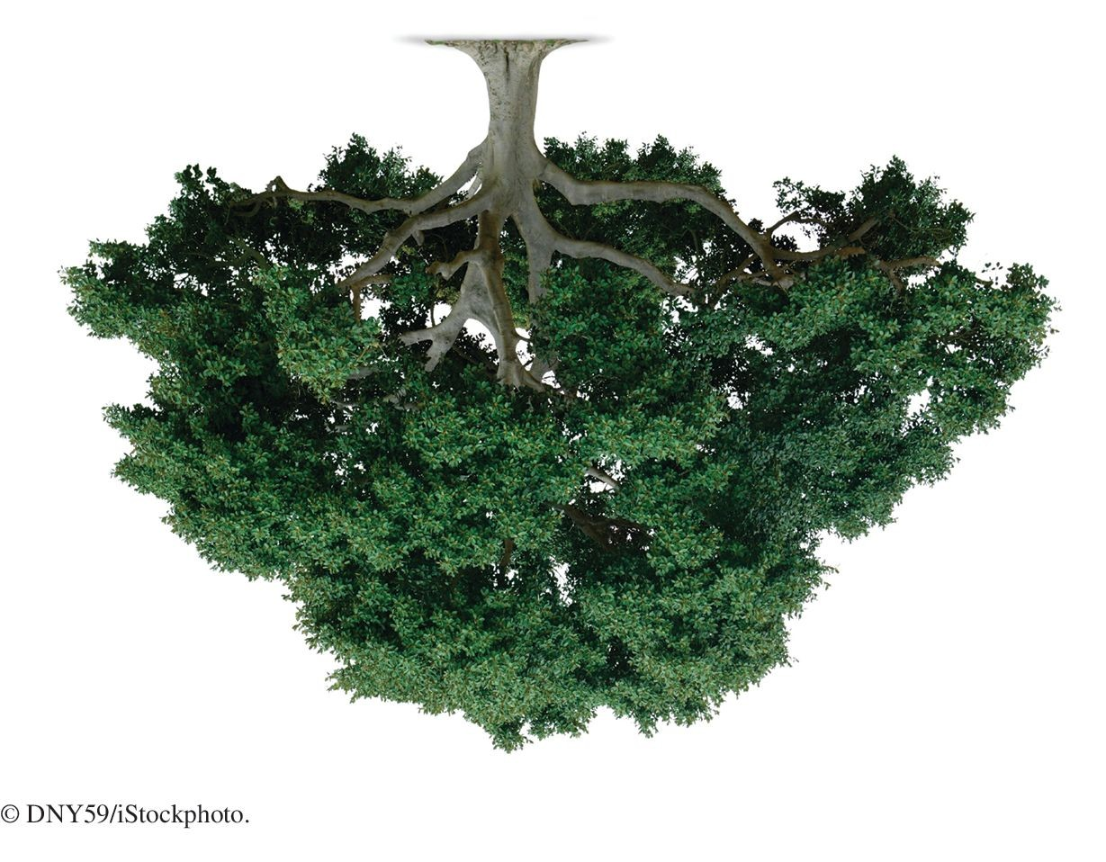
Chapter Goals
To study trees and binary trees
To understand how binary search trees can implement sets
To learn how red-black trees provide performance guarantees for set operations
To choose appropriate methods for tree traversal
To become familiar with the heap data structure
To use heaps for implementing priority queues and for sorting

Slide 3
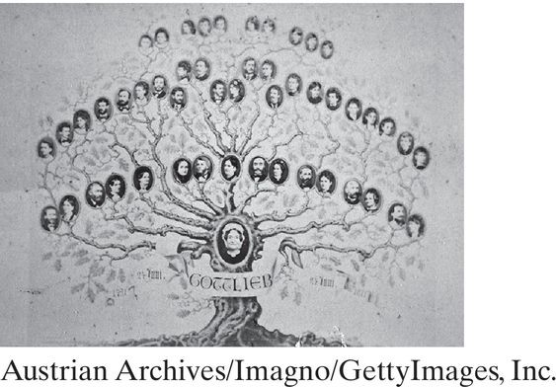
Basic Tree Concepts
A family tree shows the descendants of a common ancestor.
In computer science, a tree is a hierarchical data structure composed of nodes.
Each node has a sequence of child nodes. The root is the node with no parent.
A leaf is a node with no children.

Slide 4
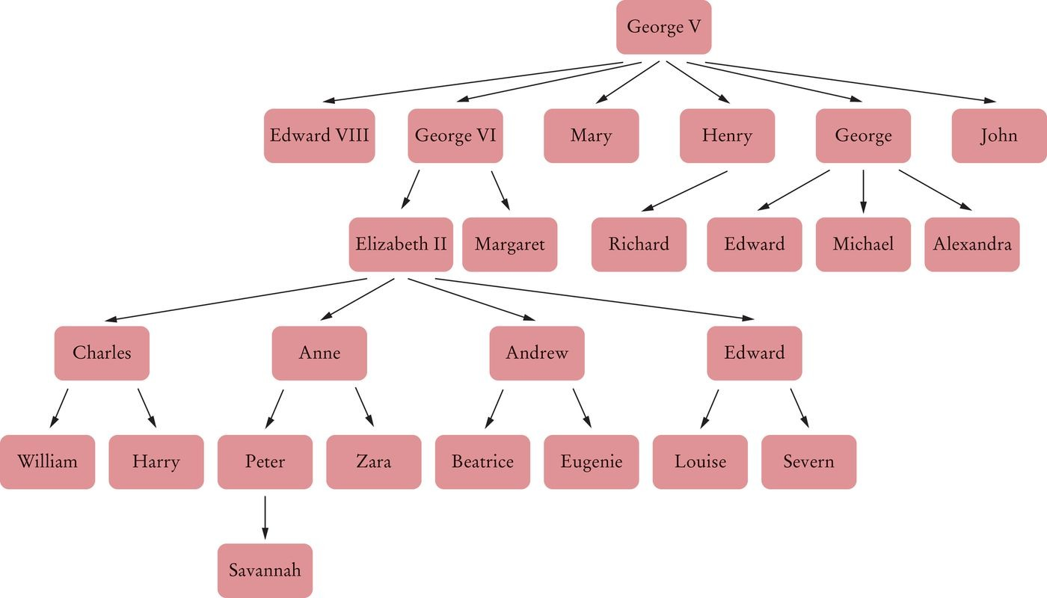
Basic Tree Concepts
British royal family tree
Figure 1 A Family Tree

Slide 5
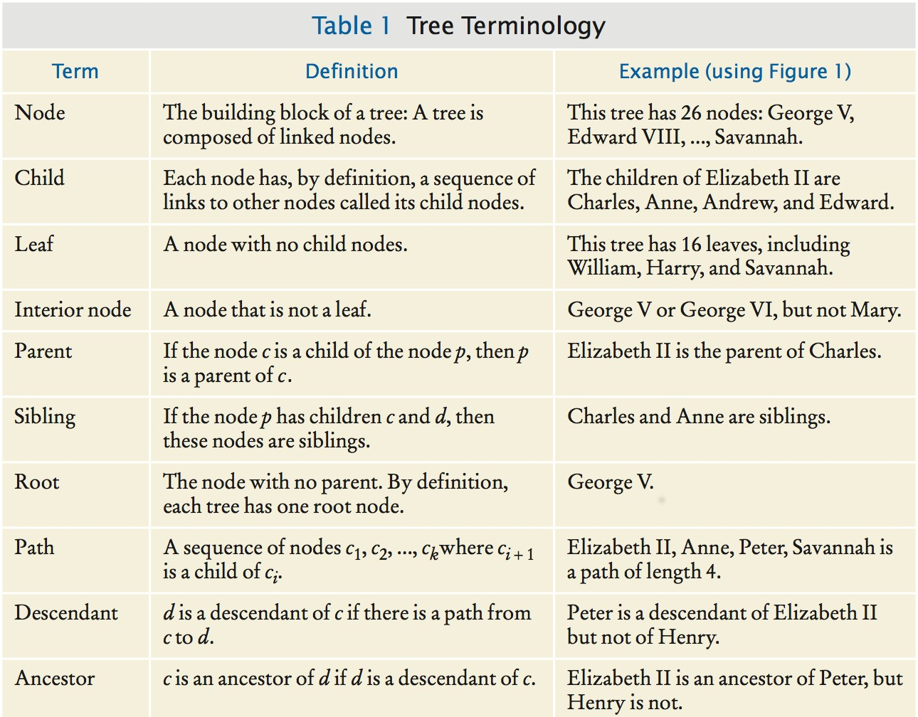
Basic Tree Concepts
Some common tree terms:

Slide 6
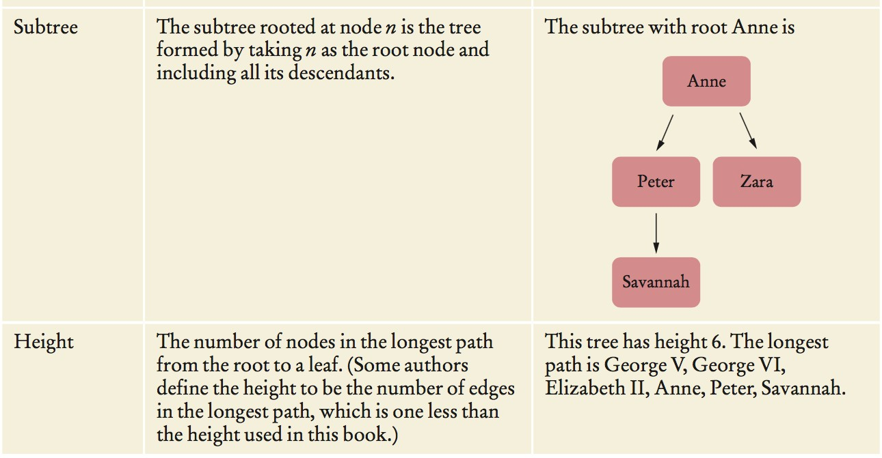

Slide 7
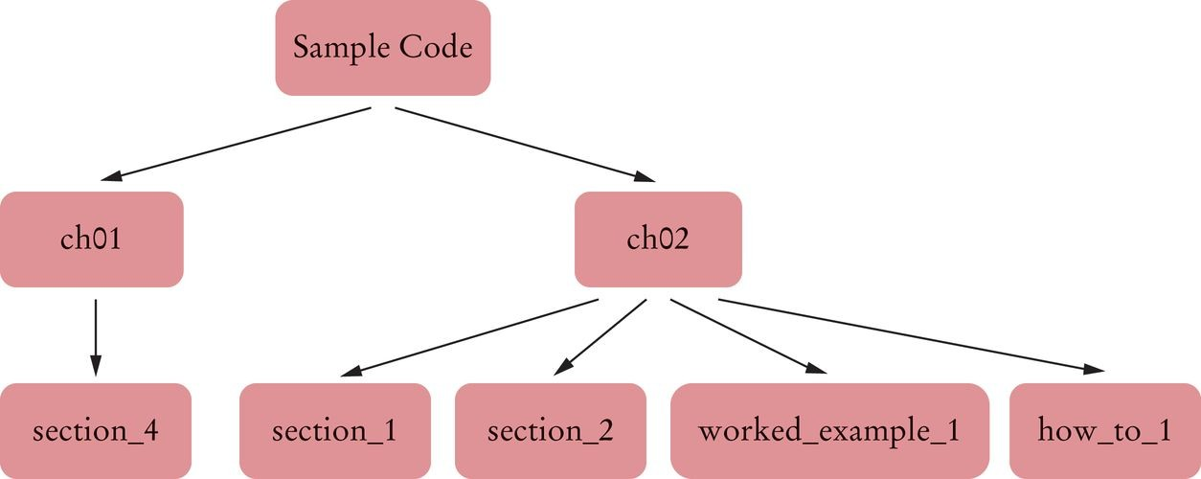
Trees in Computer Science
Figure 2 A Directory Tree

Slide 8
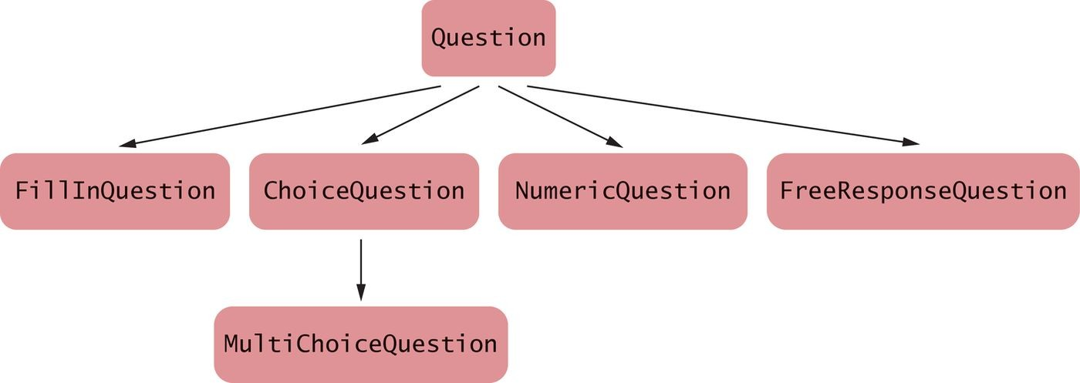
Figure 3 An Inheritance Tree

Slide 9
Basic Tree Concepts
A tree class holds a reference to a root node. Each node holds:
A data item
A list of references to the child nodes
A Tree class:
public class Tree
{
private Node root;
class Node
{
public Object data;
public List<Node> children;
}
public Tree(Object rootData)
{
root = new Node(); root.data = rootData;
root.children = new ArrayList<>();
}
public void addSubtree(Tree subtree)
{
root.children.add(subtree.root);
}
. . .
}

Slide 10
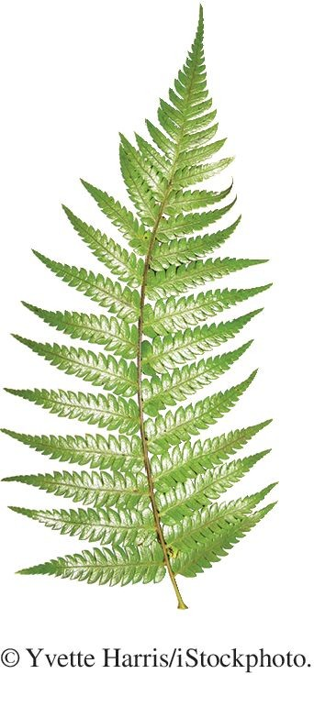
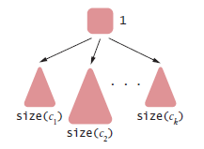
Basic Tree Concepts
When computing tree properties, it is common to recursively visit smaller and smaller subtrees.
Size of tree with root r whose children are c₁ ... c_{k}
size(r) = 1 + size(c₁) + ... + size(c_{k})

Slide 11
Basic Tree Concepts
Recursive helper method in the Node class:
class Node
{
. . .
public int size()
{
int sum = 0;
for (Node child : children) { sum = sum + child.size(); } return 1 + sum;
}
}
The size method in the Tree class invokes the helper if the
root exists:
public class Tree
{
. . .
public int size()
{
if (root == null) { return 0; } else { return root.size(); }
}
}

Slide 12
Self Check 17.1
What are the paths starting with Anne in the tree shown in Figure 1?
Answer: There are four paths: Anne
Anne, Peter
Anne, Zara
Anne, Peter, Savannah

Slide 13
Self Check 17.2
What are the roots of the subtrees consisting of 3 nodes in the tree shown in Figure 1?
Answer: There are three subtrees with three nodes— they have roots Charles, Andrew, and Edward.

Slide 14
Self Check 17.3
What is the height of the subtree with root Anne?
Answer: 3

Slide 15
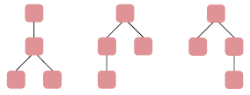
Self Check 17.4
What are all possible shapes of trees of height 3 with two leaves?
Answer:

Slide 16
Self Check 17.5
Describe a recursive algorithm for counting all leaves in a tree.
Answer:
If n is a leaf, the leaf count is 1. Otherwise
Let c₁ ... c_{n} be the children of n.
The leaf count is leafCount(c₁) + ...+ leafCount(c_{n}).

Slide 17
Self Check 17.6
Using the public interface of the Tree class in this section, construct a tree that is identical to the subtree with root Anne in Figure 1.

Slide 18
Answer:
Tree t1 = new Tree("Anne"); Tree t2 = new Tree("Peter");
t1.addSubtree(t2);
Tree t3 = new Tree("Zara"); t1.addSubtree(t3);
Tree t4 = new Tree("Savannah"); t2.addSubtree(t4);

Slide 19
Self Check 17.7
Is the size method of the Tree class recursive? Why or why not?
Answer: It is not. However, it calls a recursive method—the size
method of the Node class.

Slide 20

Binary Trees
In a binary tree, each node has a left and a right child node.

Slide 21

Binary Trees Examples - Decision Tree
A decision tree contains questions used to decide among a number of options.
In a decision tree:
Each non-leaf node contains a question.
The left subtree corresponds to a “yes” answer. The right subtree corresponds to a “no” answer. Every node has either two children or no children.

Slide 22
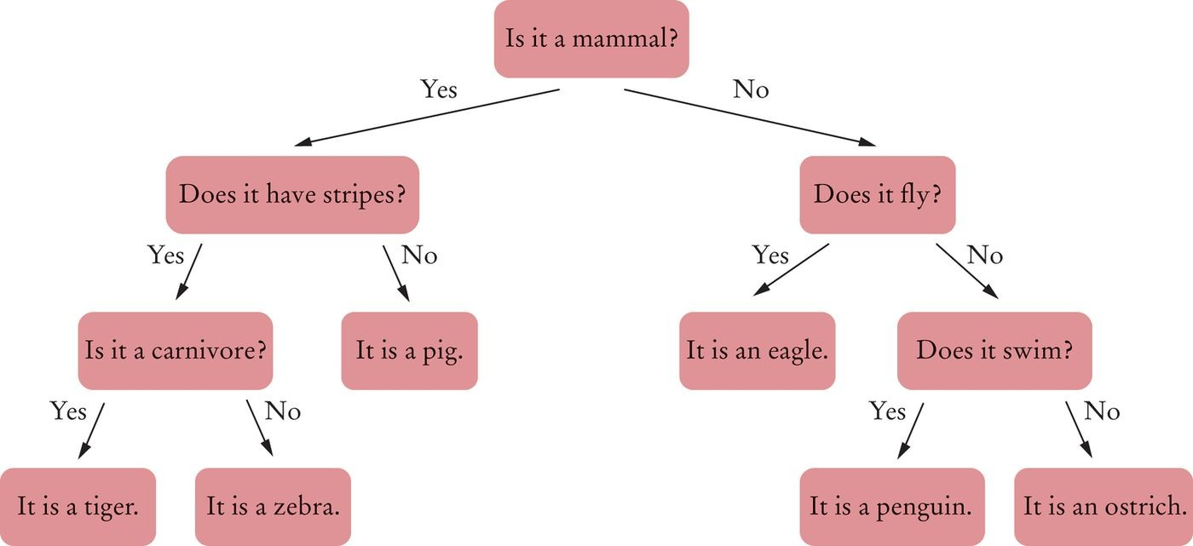
Binary Trees Examples - Decision Tree
Figure 4 A Decision Tree for an Animal Guessing Game

Slide 23
Binary Tree Examples - Huffman Tree
In a Huffman tree:
The leaves contain symbols that we want to encode.
To encode a particular symbol:
Walk along the path from the root to the leaf containing the symbol, and produce:
A zero for every left turn. A one for every right turn.

Slide 24
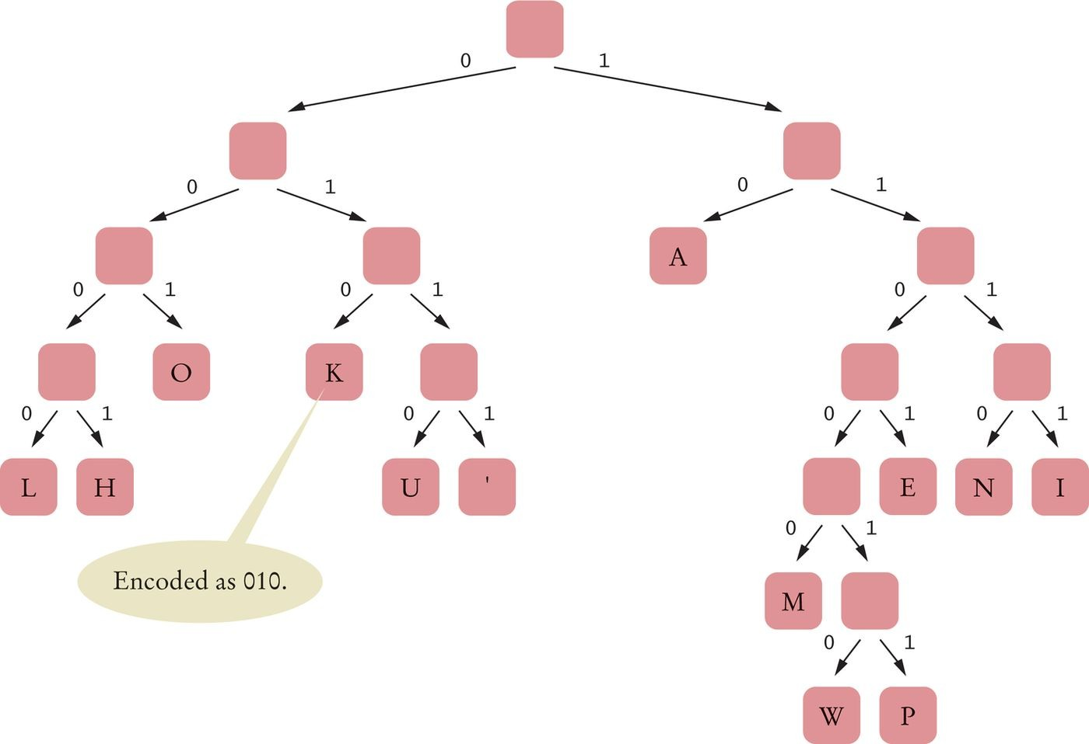
Binary Tree Examples - Huffman Tree
Figure 5 A Huffman Tree for Encoding the Thirteen Characters of Hawaiian Alphabet

Slide 25
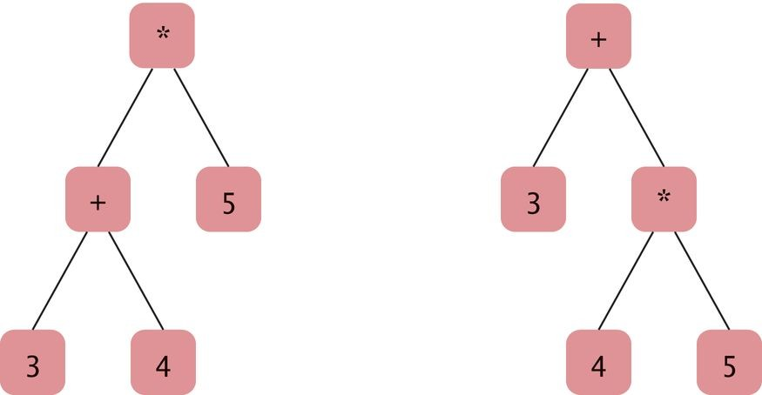
Binary Tree Examples - Expression Tree
An expression tree shows the order of evaluation in an arithmetic expression.
The leaves of the expression trees contain numbers. Interior nodes contain the operators.
(3 + 4) * 5 and 3 + 4 * 5
Figure 6 Expression Trees

Slide 26

Balanced Trees
In a balanced binary tree, each subtree has approximately the same number of nodes.

Slide 27
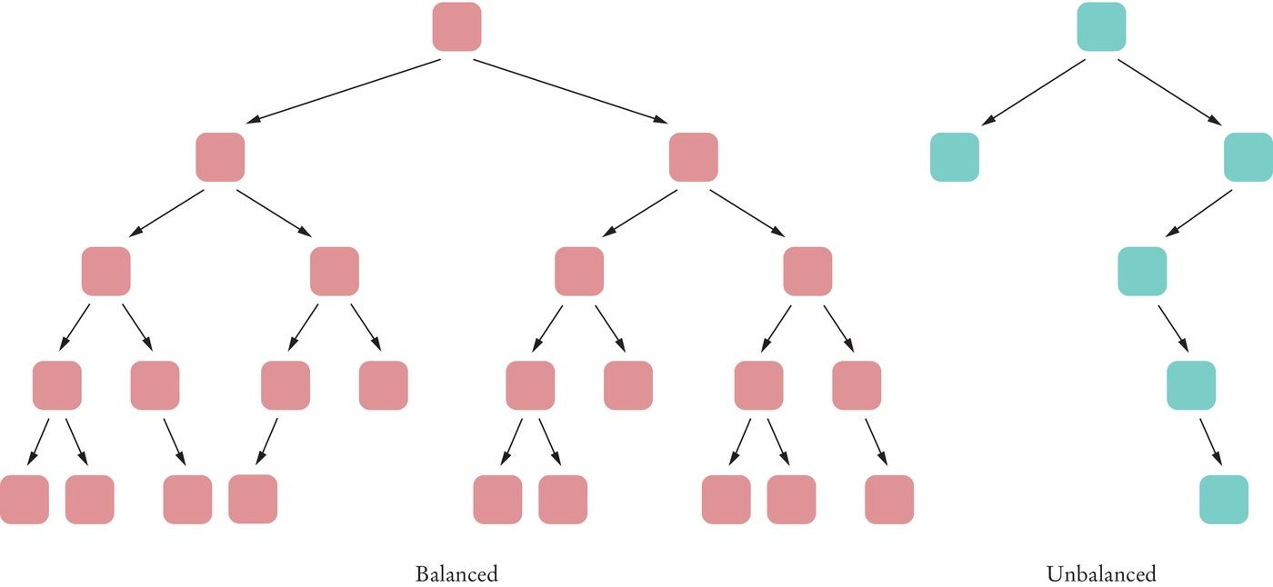
Balanced Trees
Figure 7 Balanced and Unbalanced Trees

Slide 28
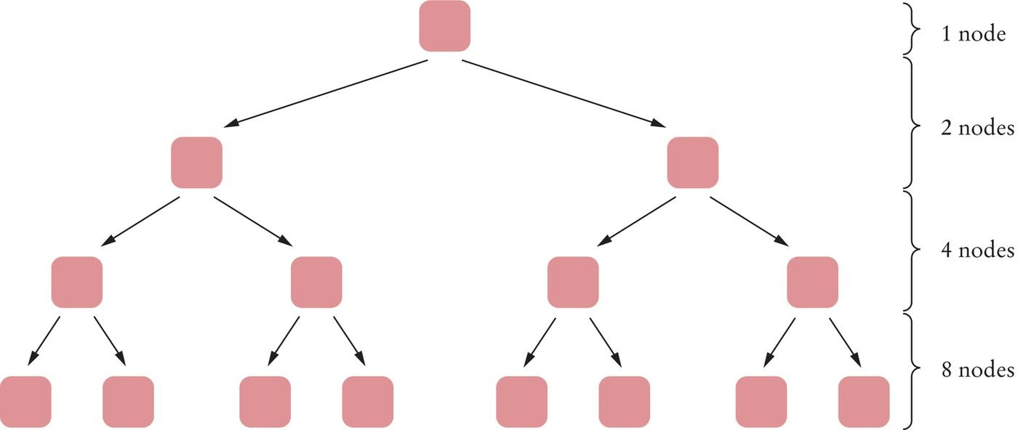
Balanced Trees
A binary tree of height h can have up to n =
₂h
– 1 nodes.
A completely filled binary tree of height 4 has 1 + 2 + 4 + 8 = 15 =
2⁴ – 1 nodes.
Figure 8 A Completely Filled Binary Tree of Height 4
For a completely filled binary tree: h = log₂(n + 1)

Slide 29
For a balanced tree: h ≈ log₂(n)
Example: the height of a balanced binary tree with 1,000 nodes
Approximately 10 (because 1000 ≈ 1024 = 2¹⁰).
Example: the height of a balanced binary tree with 1,000,000 nodes
Approximately 20 (because 10⁶ ≈ 2²⁰)
You can find any element in this tree in about 20 steps.

Slide 30
A Binary Tree Implementation
Binary tree node has a reference:
to a right child to a left child
either can be null
Leaf: node in which both children are null.

Slide 31
A Binary Tree Implementation
BinaryTree class:
public class BinaryTree
{
private Node root;
public BinaryTree() { root = null; } // An empty tree
public BinaryTree(Object rootData, BinaryTree left, BinaryTree right)
{
root = new Node(); root.data = rootData; root.left = left.root; root.right = right.root;
}
class Node
{
public Object data; public Node left; public Node right;
}
. . .
}

Slide 32
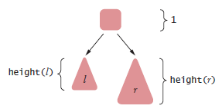
A Binary Tree Implementation
To find the height of a binary tree t with left and right children l and
r
Take the maximum height of the two children and add 1
height(t) = 1 + max(height(l), height(r))

Slide 33
A Binary Tree Implementation
Make a static recursive helper method height in the Tree class:
public class BinaryTree
{
. . .
private static int height(Node n)
{
if (n == null) { return 0; }
else { return 1 + Math.max(height(n.left), height(n.right)); }
}
. . .
}
Provide a public height method in the Tree class:
public class BinaryTree
{
. . .
public int height() { return height(root); }
}

Slide 34
Self Check 17.8
Encode ALOHA, using the Huffman code in Figure 5.
Answer:
A=10, L=0000, O=001, H=0001, therefore ALOHA = 100000001000110.

Slide 35
Self Check 17.9
In an expression tree, where is the operator stored that gets executed last?
Answer: In the root.

Slide 36
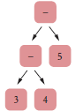
Self Check 17.10
What is the expression tree for the expression 3 – 4 – 5?
Answer:

Slide 37

Self Check 17.11
How many leaves do the binary trees in Figure 4, Figure 5, and Figure 6 have? How many interior nodes?
Answer:
Figure 4: 6 leaves, 5 interior nodes.
Figure 5: 13 leaves, 12 interior nodes.
Figure 6: 3 leaves, 2 interior nodes.
You might guess from these data that the number of leaves always equals the number of interior nodes + 1. That is true if all interior nodes have two children, but it is false otherwise— consider this tree whose root only has one child.

Slide 38
Self Check 17.12
Show how the recursive height helper method can be implemented as an instance method of the Node class. What is the disadvantage of that approach? Answer:
public class BinaryTree
{
. . .
public int height()
{
if (root == null) { return 0; } else { return root.height(); }
}
class Node
{
. . .
public int height()
{
int leftHeight = 0; if (left != null)
{
leftHeight = left.height();
}
int rightHeight = 0; if (right != null)
{
rightHeight = right.height();
}
return 1 + Math.max(leftHeight, rightHeight);
}
}
}
This solution requires three null checks; the solution in Section 17.2.3 only requires one.

Slide 39
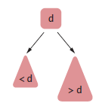
Binary Search Trees
All nodes in a binary search tree fulfill this property:
The descendants to the left have smaller data values than the node data value.
The descendants to the right have larger data values.

Slide 40
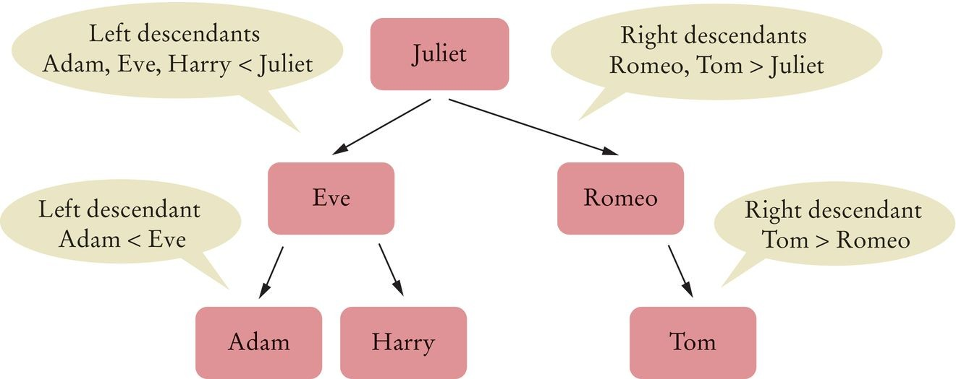
Binary Search Trees
Figure 9 A Binary Search Tree

Slide 41
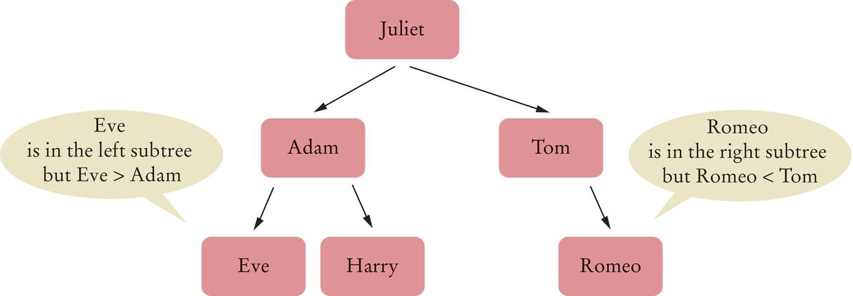
Binary Search Trees
Figure 10 A Binary Tree That Is Not a Binary Search Tree

Slide 42
Binary Search Trees
The data variable must have type Comparable. BinarySearchTree
public class BinarySearchTree
{
private Node root;
public BinarySearchTree() { . . . } public void add(Comparable obj) { . . . }
. . .
class Node
{
public Comparable data; public Node left; public Node right;
public void addNode(Node newNode) { . . . }
. . .
}
}

Slide 43
Binary Search Trees - Insertion
Algorithm to insert data:
If you encounter a non-null node reference, look at its data value.
If the data value of that node is larger than the value you want to insert,
Continue the process with the left child.
If the node’s data value is smaller than the one you want to insert,
Continue the process with the right child.
If the node’s data value is the same as the one you want to insert,
You are done. A set does not store duplicate values.
If you encounter a null node reference, replace it with the new node.

Slide 44
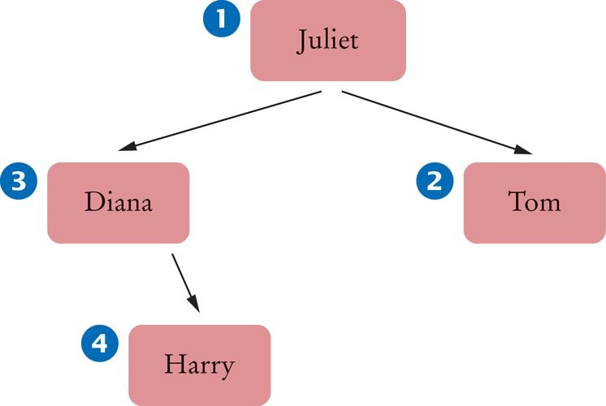
Binary Search Trees - Insertion
BinarySearchTree tree = new BinarySearchTree(); tree.add("Juliet");
tree.add("Tom");
tree.add("Diana");
tree.add("Harry");
Figure 11 Binary Search Tree After Four Insertions

Slide 45
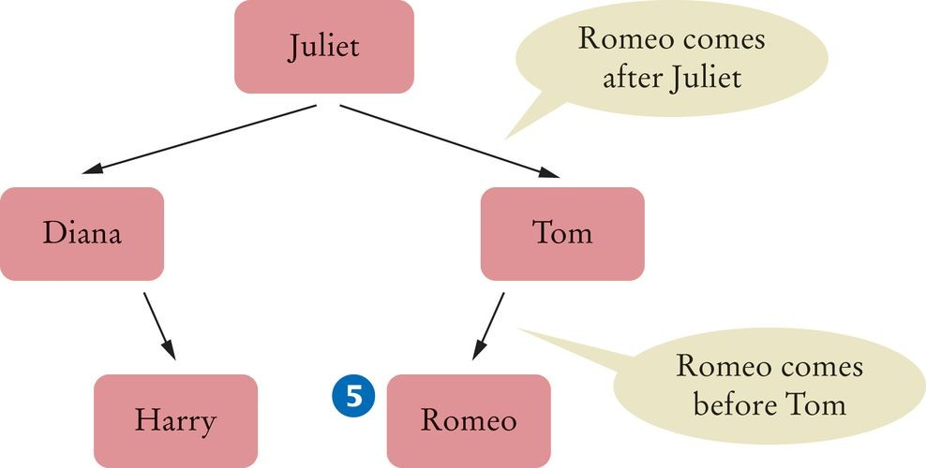
Binary Search Trees - Insertion
tree.add("Romeo");
Figure 12 Binary Search Tree After Five Insertions

Slide 46
Binary Search Trees - Insertion
add method in BinarySearchTree:
public void add(Comparable obj)
{
Node newNode = new Node(); newNode.data = obj; newNode.left = null; newNode.right = null;
if (root == null) { root = newNode; } else { root.addNode(newNode); }
}
addNode method of the Node class:
class Node
{
. . .
public void addNode(Node newNode)
{
int comp = newNode.data.compareTo(data); if (comp < 0)
{
if (left == null) { left = newNode; } else { left.addNode(newNode); }
}
else if (comp > 0)
{
if (right == null) { right = newNode; } else { right.addNode(newNode); }
}
}
. . .
}

Slide 47
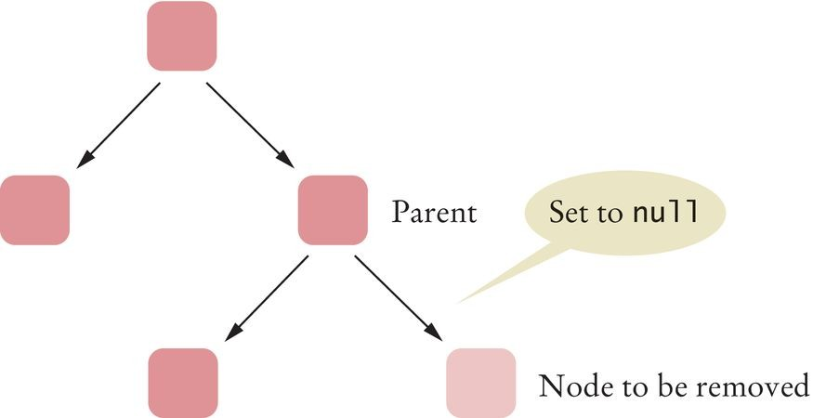
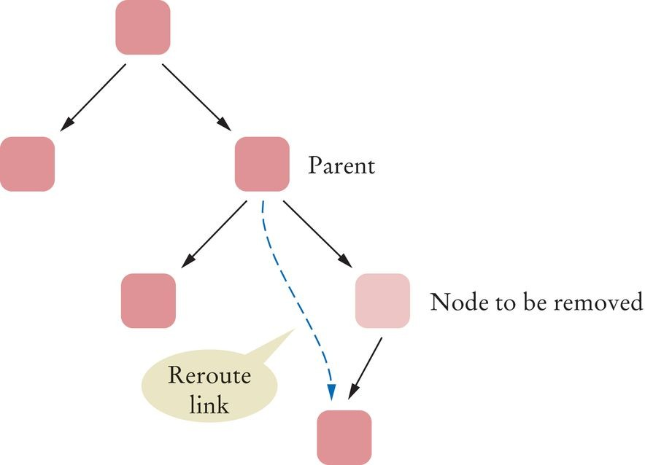
Binary Search Trees - Removal
First, find the node.
Case 1: The node has no children
Set the link in the parent to null
Figure 13 Removing a Node with No Children
Case 2: The node has 1 child
Modify the parent link to the node to point to the child node
Figure 14 Removing a Node with One Child

Slide 48
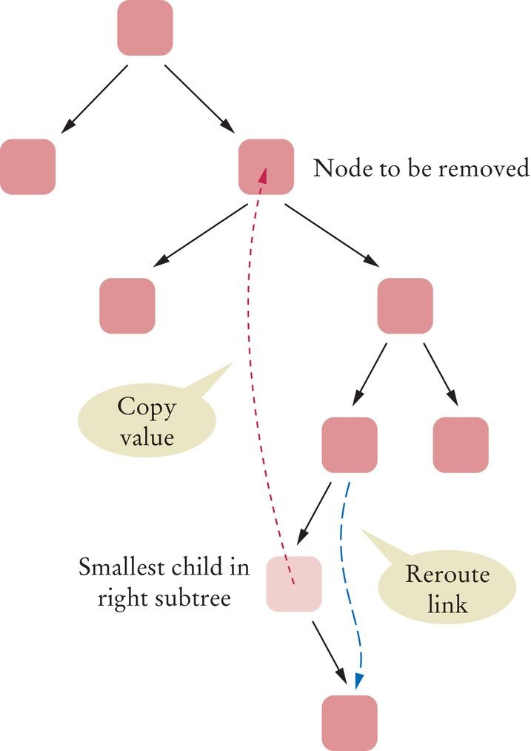
Binary Search Trees - Removal
Case 3: The node has 2 children
Replace it with the smallest node of the right subtree
Figure 15 Removing a Node with Two Children

Slide 49
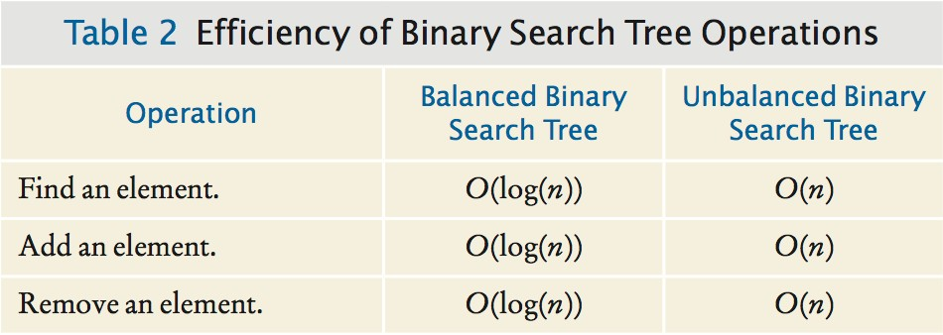
Binary Search Trees - Efficiency of the Operations
If a binary search tree is balanced, then adding, locating, or removing an element takes O(log(n)) time.

Slide 50
section_3/BinarySearchTree.java
1 /**
This class implements a binary search tree whose
nodes hold objects that implement the Comparable
interface.
5 */
6 public class BinarySearchTree
7 {
8 private Node root;
9
10
11
12
13
14
15
16
17
18
19
20
21
22
23
24
25
26
27
28
29
30
31
32
33
34
/**
Constructs an empty tree.
*/
public BinarySearchTree()
{
root = null;
}
/**
Inserts a new node into the tree.
@param obj the object to insert
*/
public void add(Comparable obj)
{
Node newNode = new Node(); newNode.data = obj; newNode.left = null; newNode.right = null;
if (root == null) { root = newNode; } else { root.addNode(newNode); }
}
/**
Tries to find an object in the tree.
@param obj the object to find

Slide 51
Self Check 17.13
What is the difference between a tree, a binary tree, and a balanced binary tree?
Answer: In a tree, each node can have any number of children. In a binary tree, a node has at most two children. In a balanced binary tree, all nodes have approximately as many descendants to the left as to the right.

Slide 52
Self Check 17.14
Are the left and right children of a binary search tree always binary search trees? Why or why not?
Answer: Yes––because the binary search condition holds for all nodes of the tree, it holds for all nodes of the subtrees.

Slide 53
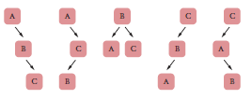
Self Check 17. 15
Draw all binary search trees containing data values A, B, and C.
Answer:

Slide 54
Self Check 17.16
Give an example of a string that, when inserted into the tree of Figure 12, becomes a right child of Romeo.
Answer: For example, Sarah. Any string between Romeo and
Tom will do.

Slide 55
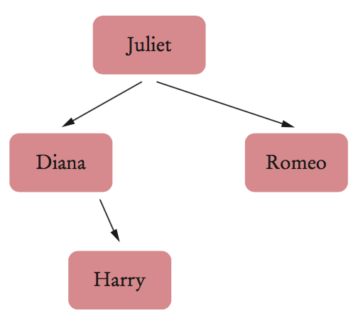
Self Check 17.17
Trace the removal of the node “Tom” from the tree in Figure 12.
Answer: “Tom” has a single child. That child replaces “Tom” in the parent “Juliet”.

Slide 56
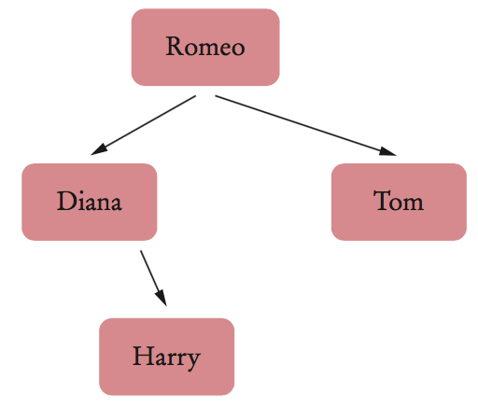
Self Check 17.18
Trace the removal of the node “Juliet” from the tree in Figure 12.
Answer: “Juliet” has two children. We look for the smallest child in the right subtree, “Romeo”. The data replaces “Juliet”, and the node is removed from its parent “Tom”.

Slide 57
Tree Traversal - Inorder Traversal
To print a Binary Search Tree in sorted order:
Print the left subtree. Print the root data.
Print the right subtree.
This called an inorder traversal.
Recursive helper method for printing the tree:
private static void print(Node parent)
{
if (parent == null) { return; } print(parent.left); System.out.print(parent.data + " "); print(parent.right);
}
Public print method starts the recursive process at the root:
public void print()
{
print(root);
}

Slide 58
Preorder and Postorder Traversals
Preorder
Visit the root Visit left subtree
Visit the right subtree
Postorder
Visit left subtree
Visit the right subtree Visit the root
A postorder traversal of an expression tree results in an expression in reverse Polish notation.

Slide 59
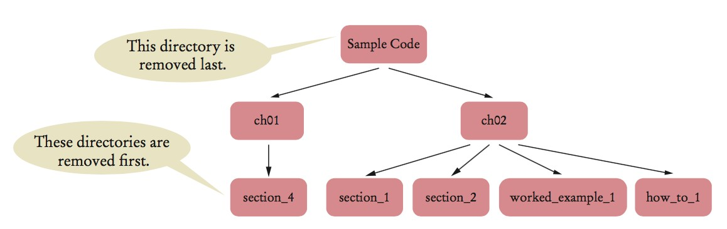
Preorder and Postorder Traversals
Use postorder traversal to remove all directories from a directory tree.
A directory must be empty before you can remove it.
Use preorder traversal to copy a directory tree.

Slide 60
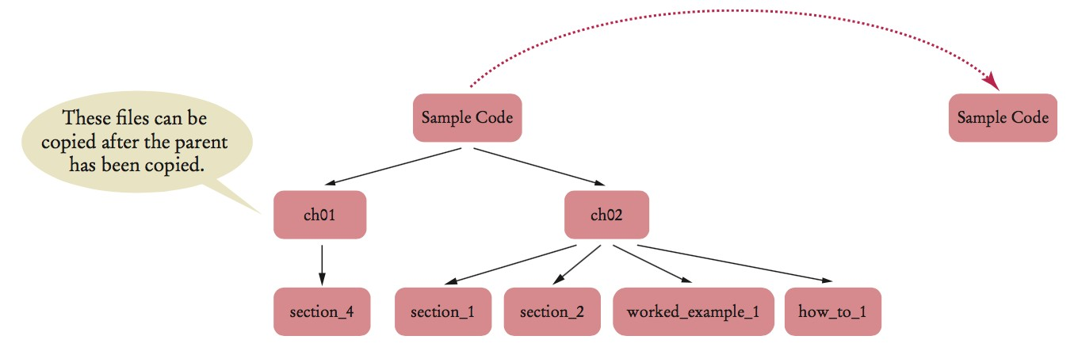
Can have pre- and post-order traversal for any tree. Only a binary tree has an inorder traversal.

Slide 61
The Visitor Pattern
Visitor interface to define action to take when visiting the nodes:
public interface Visitor
{
void visit(Object data);
}
Preorder traversal with a Visitor:
private static void preorder(Node n, Visitor v)
{
if (n == null) { return; } v.visit(n.data);
for (Node c : n.children) { preorder(c, v); }
}
public void preorder(Visitor v) { preorder(root, v); }
You can also create visitors with inorder or postorder.

Slide 62
The Visitor Pattern
Example: Count all the names with at most 5 letters.
public static void main(String[] args)
{
BinarySearchTree bst = . . .;
class ShortNameCounter implements Visitor
{
public int counter = 0;
public void visit(Object data)
{
if (data.toString().length() <= 5) { counter++; }
}
}
ShortNameCounter v = new ShortNameCounter(); bst.inorder(v);
System.out.println("Short names: " + v.counter);
}

Slide 63
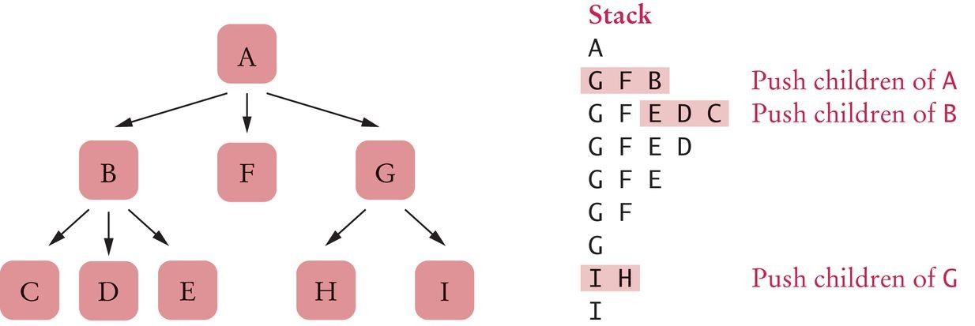
Depth-First Search
Iterative traversal can stop when a goal has been met. Depth-first search uses a stack to track the nodes that it still needs to visit.
Algorithm:
Push the root node on a stack. While the stack is not empty
Pop the stack; let n be the popped node. Process n.
Push the children of n on the stack, starting with the last one.
Figure 16 Depth-First Search

Slide 64
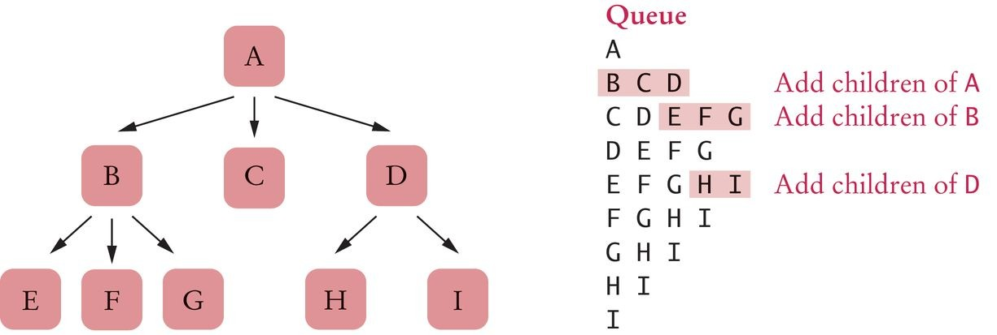
Breadth-First Search
Breadth-first search first visits all nodes on the same level before visiting the children.
Breadth-first search uses a queue.
Figure 17 Breadth-First Search
Modify the Visitor interface to return false when the traversal should stop

Slide 65
Breadth-First Search
An implementation:
public interface Visitor
{
boolean visit(Object data);
}
public void breadthFirst(Visitor v)
{
if (root == null) { return; } Queue<Node> q = new LinkedList<Node>(); q.add(root);
boolean more = true;
while (more && q.size() > 0)
{
Node n = q.remove(); more = v.visit(n.data); if (more)
{
for (Node c : n.children) { q.add(c); }
}
}
}

Slide 66
Tree Iterators
The Java collection library has an iterator to process trees:
TreeSet<String> t = . . . Iterator<String> iter = t.iterator(); String first = iter.next();
String second = iter.next();
A breadth first iterator:
class BreadthFirstIterator
{
private Queue<Node> q;
public BreadthFirstIterator(Node root)
{
q = new LinkedList<Node>();
if (root != null) { q.add(root); }
}
public boolean hasNext() { return q.size() > 0; } public Object next()
{
Node n = q.remove();
for (Node c : n.children) { q.add(c); } return n.data;
}
}

Slide 67
Self Check 17.19
What are the inorder traversals of the two trees in Figure 6 on page 771?
Answer: For both trees, the inorder traversal is 3 + 4 * 5.

Slide 68
Self Check 17.20
Are the trees in Figure 6 binary search trees?
Answer: No—for example, consider the children of +. Even without looking up the Unicode values for 3, 4, and +, it is obvious that + isn't between 3 and 4.

Slide 69
Self Check 17.21
Why did we have to declare the variable v in the sample program in Section 17.4.3 as
ShortNameCounter and not as Visitor?
Answer: Because we need to call v.counter in order to retrieve the result.

Slide 70
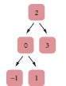
Self Check 17.22
Consider this modification of the recursive inorder traversal. We want traversal to stop as soon as the visit method returns false for a node.
public static void inorder(Node n, Visitor v)
{
if (n == 0) { return; } inorder(n.left, v);
if (v.visit(n.data)) { inorder(n.right, v); }
}
Why doesn't that work?
Answer: When the method returns to its caller, the caller can continue traversing the tree. For example, suppose the tree is
Let’s assume that we want to stop visiting as soon as we encounter a zero, so visit returns false when it receives a zero. We first call inorder on the node containing 2. That calls inorder on the node containing 0, which calls inorder on the node containing –1. Then visit is called on 0, returning false.

Slide 71
Therefore, inorder is not called on the node containing 1, and the inorder call on the node containing 0 is finished, returning to
the inorder call on the root node. Now visit is called on 2, returning true, and the visitation continues, even though it shouldn't. See Exercise E17.10 for a fix.

Slide 72
Self Check 17.23
In what order are the nodes in Figure 17 visited if one pushes children on the stack from left to right instead of right to left?
Answer: AGIHFBEDC

Slide 73
Self Check 17.24
What are the first eight visited nodes in the breadth-first traversal of the tree in Figure 1?
Answer: That’s the royal family tree, the first tree in the chapter: George V, Edward VIII, George VI, Mary, Henry, George, John, Elizabeth II.

Slide 74
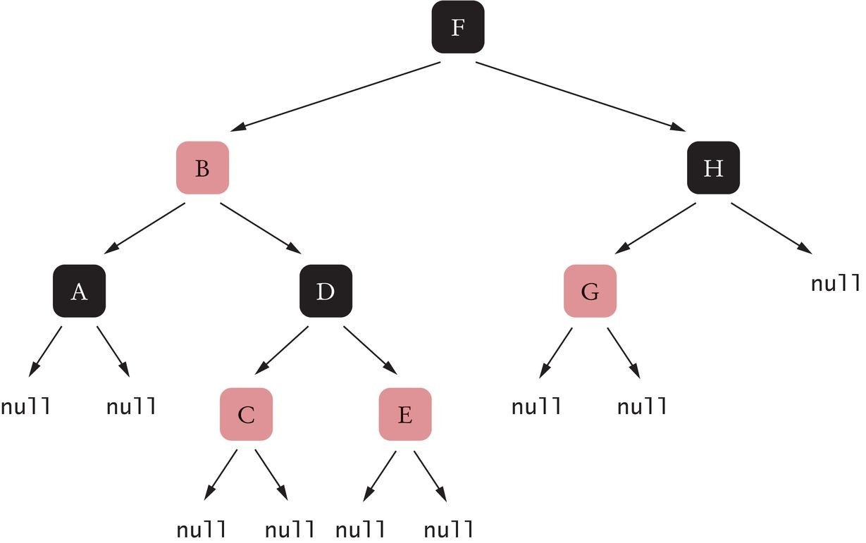
Red-Black Trees
A kind of binary search tree that rebalances itself after each insertion or removal.
Guaranteed O(log(n)) efficiency. Additional requirements:
Every node is colored red or black. The root is black.
A red node cannot have a red child (the “no double reds” rule).
All paths from the root to a null have the same number of black nodes (the “equal exit cost” rule).
Example
Figure 18 A Red-Black Tree

Slide 75

Red-Black Trees
Think of each node of a red-black tree as a toll booth. The total toll to each exit is the same.

Slide 76
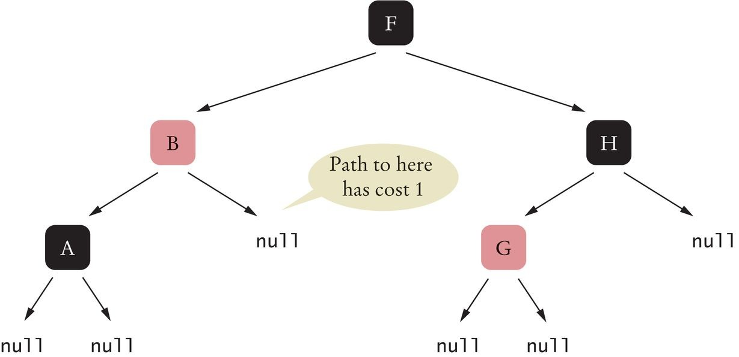
Red-Black Trees
Figure 19 A Tree that Violates "Equal Exit Cost" Rule

Slide 77
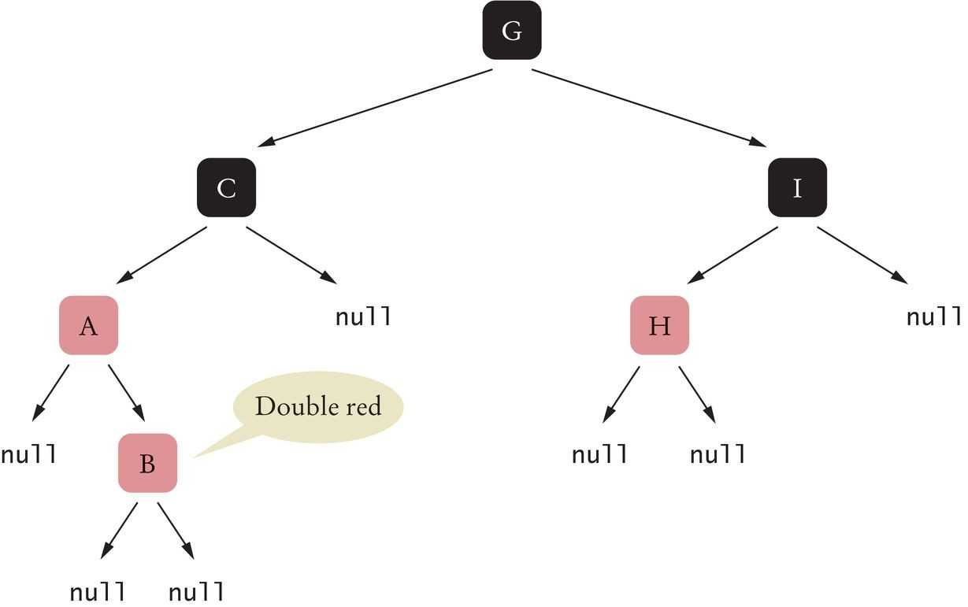
Figure 20 A Tree that Violates the "No Double Red" Rule

Slide 78
Red-Black Trees
The “equal exit cost” rule eliminates highly unbalanced trees.
You can’t have null references high up in the tree.
The nodes that aren't near the leaves need to have two children.
The “no double reds” rule gives some flexibility to add nodes without having to restructure the tree all the time.
Some paths can be a bit longer than others None can be longer than twice the black height.

Slide 79
Red-Black Trees
Black height of a node:
The cost of traveling on a path from a given node to a null The number of black nodes on the path
Black height of the tree:
The cost of traveling from the root to a null
Tree with black height bh
must have at least 2^{bh} – 1 nodes bh ≤ log(n + 1)
The “no double reds” rule says that the total height h of a tree is at most twice the black height:
h ≤ 2 · bh ≤ 2 · log(n + 1)
Traveling from the root to a null is O(log(n)).

Slide 80
Red-Black Trees - Insertion
First insert the node as into a regular binary search tree:
If it is the root, color it black Otherwise, color it red
If the parent is black, it is a red-black tree.
If the parent is red, need to fix the "double red" violation. We know the grandparent is black.

Slide 81
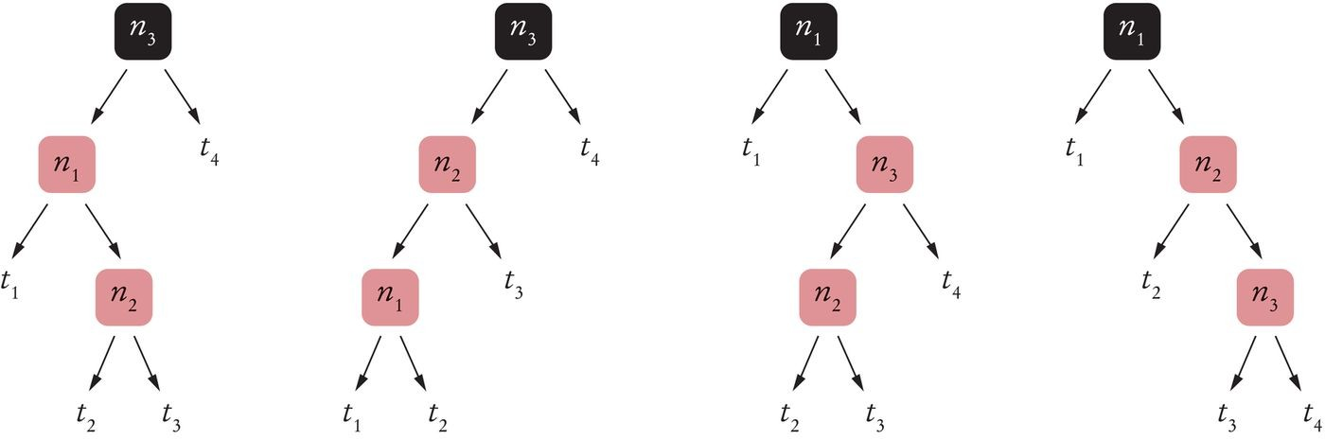
Red-Black Trees - Insertion
Four possible configurations given black grandparent:
Smallest, middle, and largest labeled n₁, n₂, n₃
Their children are labeled in sorted order, starting with t₁
Figure 21 The Four Possible Configurations of a "Double Red"

Slide 82
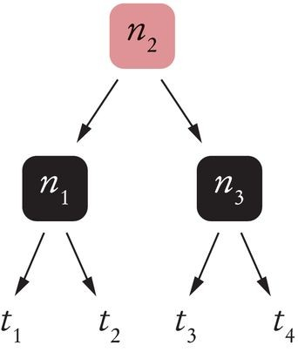
Red-Black Trees - Insertion
Re-arrange n₂ with children n₁ and n₃ colored black.
Figure 22 Fixing the "Double Red" Violation
Move up the tree fixing any other "double-red" problems in the same way.
If the troublesome red parent is the root,
Turn it black.
That will add 1 to all paths, preserving "equal exit cost" rule.

Slide 83
Red-Black Trees - Insertion
When the height of the binary search tree is h:
Finding the insertion point takes at most h steps. Fixing double-red violations takes at most h / 2.
Because we know h = O(log(n)), insertion is guaranteed
O(log(n)) efficiency.

Slide 84
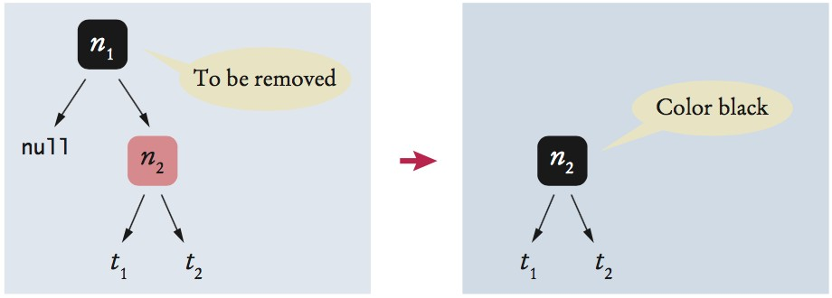
Red-Black Trees - Removal
Before removing a node in a red-black tree, turn it red and fix any double-black and double-red violations.
First remove the node as in a regular binary search tree. If the node to be removed is red, just remove it.
If the node to be removed is black and has a child:
Color that child black
Troublesome case is removal of a black leaf.
Just removing it will cause an "equal exit cost" violation. So turn it into a red node.

Slide 85
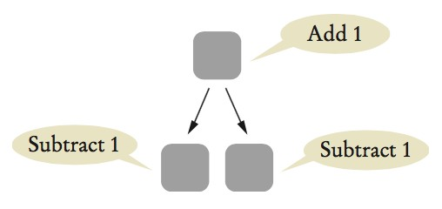
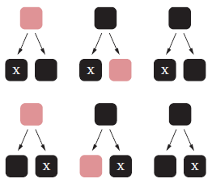
Red-Black Trees - Removal
To turn a black node into a red one:
Bubble up the cost by adding one to the parent and subtracting 1 from the children.
Results in six possible configurations:
May result in a double black and negative red. Transform in this manner:

Slide 86
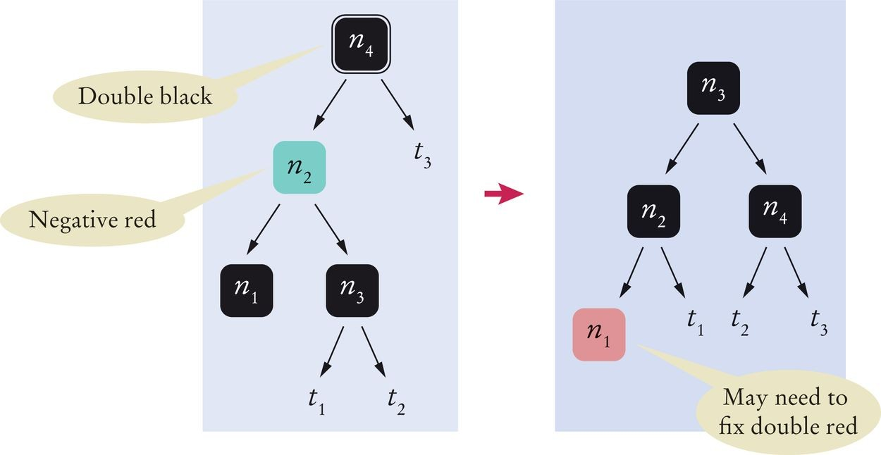
Figure 23 Eliminating a Negative-Red Node with a Double-Black Parent

Slide 87
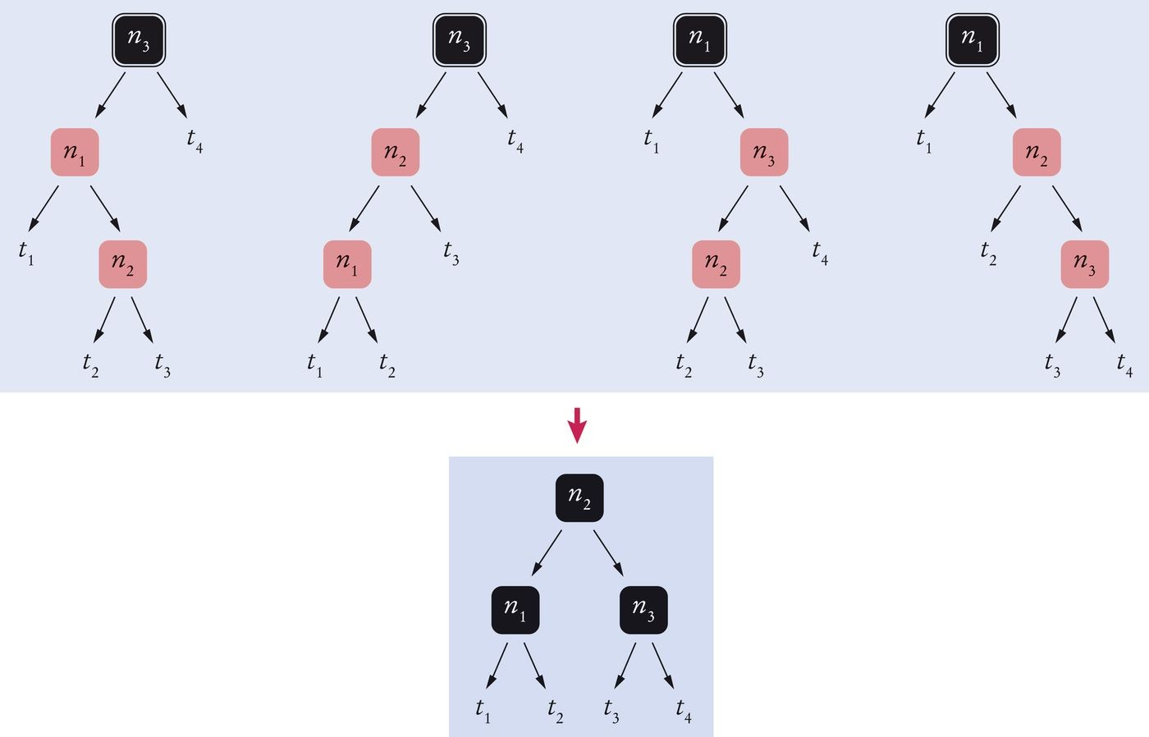
Red-Black Trees - Removal
Fixing a Double-Red Violation Also Fixes a Double-Black Grandparent
Figure 24 Fixing a Double-Red Violation Also Fixes a Double-Black Grandparent

Slide 88
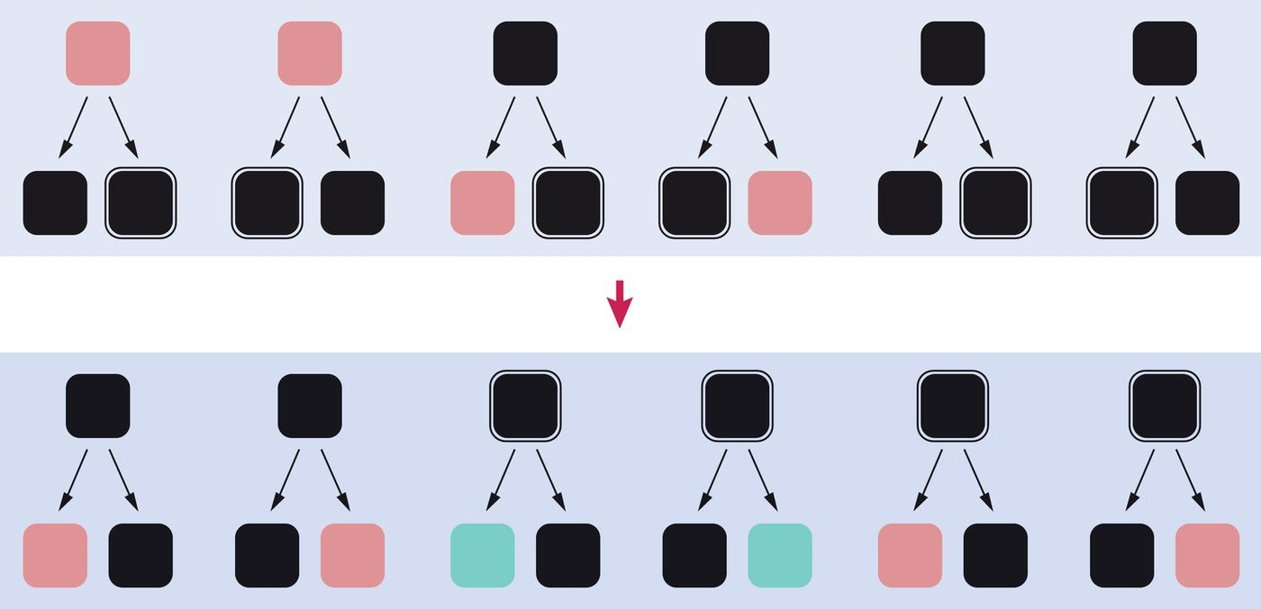
Red-Black Trees - Removal
Figure 25 Bubbling Up a Double-Black Node
If a double black reaches the root, replace it with a regular black:
Reduces the cost of all paths by 1
Preserves the "equal exit cost" rule

Slide 89
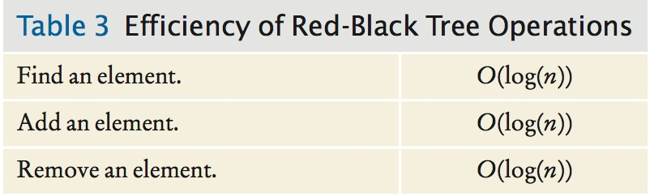
Red-Black Trees - Efficiency

Slide 90
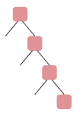
Self Check 17.25
Consider the extreme example of a tree with only right children and at least three nodes. Why can’t this be a red-black tree?
Answer: The root must be black, and the second or third node must also be black, because of the “no double reds” rule. The left
null of the root has black height 1, but the null child of the next black node has black height 2.

Slide 91
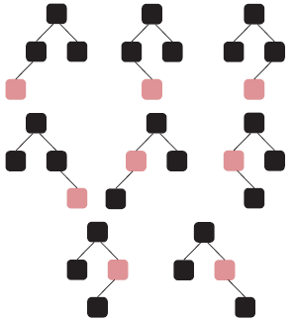
Self Check 17.26
What are the shapes and colorings of all possible red-black trees that have four nodes?
Answer:

Slide 92
Self Check 17.27
Why does Figure 21 show all possible configurations of a double-red violation?
Answer: The top red node can be the left or right child of the black parent, and the bottom red node can be the left or right child of its (red) parent, yielding four configurations.

Slide 93
Self Check 17.28
When inserting an element, can there ever be a triple-red violation in Figure 21? That is, can you have a red node with two red children? (For example, in the first tree, can t1 have a red root?)
Answer: No. Look at the first tree. At the beginning, n₂ must have
been the inserted node. Because the tree was a valid red-black tree before insertion, t₁ couldn't have had a red root. Now
consider the step after one double-red removal. The parent of n₂ in Figure 22 may be red, but then n₂ can't have a red sibling— otherwise the tree would not have been a red-black tree.

Slide 94
Self Check 17.29
When removing an element, show that it is possible to have a triple-red violation in Figure 23.
Answer: Consider this scenario, where X is the black leaf to be removed.

Slide 95
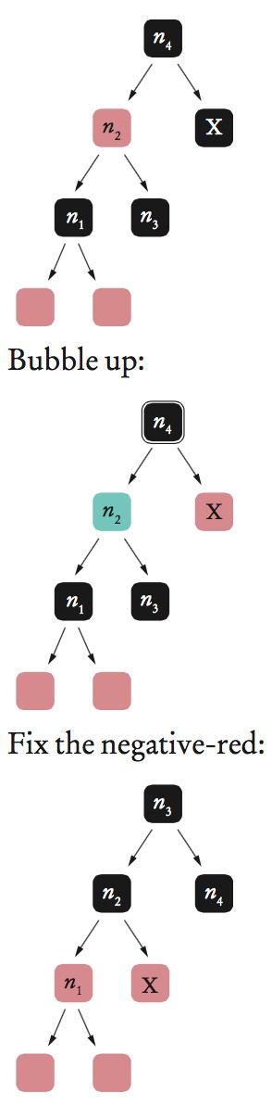

Slide 96
Self Check 17.30
What happens to a triple-red violation when the double-red fix is applied?
Answer: It goes away. Suppose the sibling of the red grandchild in Figure 21 is also red. That means that one of the t_{i} has a red
root. However, all of them become children of the black n₁ and n₃
in Figure 22.

Slide 97
Heaps
A heap (min-heap):
Binary tree
Almost completely filled:
All nodes are filled in, except the last level.
May have some nodes missing toward the right.
All nodes fulfill the heap property:
The value of any node is less than or equal to the values of its descendants.
The value of the root is the minimum of all all the values in the tree.

Slide 98
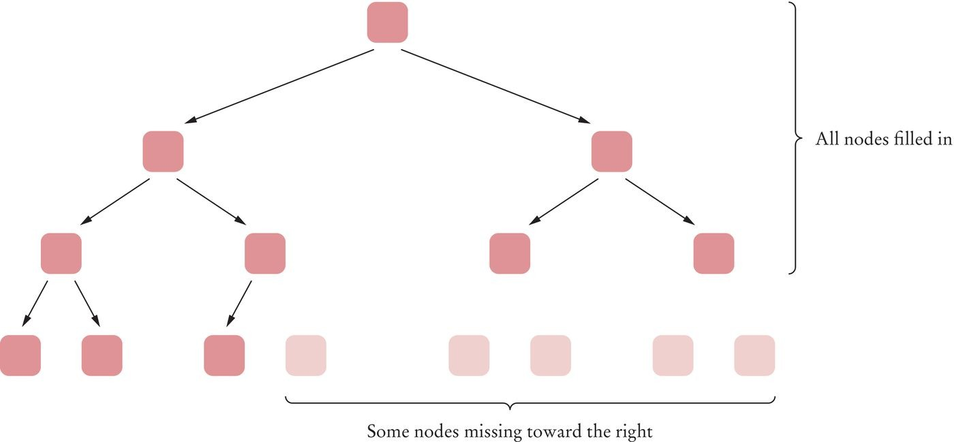
Heaps
Figure 26 An Almost Completely Filled Tree

Slide 99

Heaps
In an almost complete tree, all layers but one are completely filled.

Slide 100

Heaps
Figure 27 A Heap
The value of every node is smaller than all its descendants.

Slide 101
Heaps
Differences from a binary search tree
The shape of a heap is very regular.
Binary search trees can have arbitrary shapes.
In a heap, the left and right subtrees both store elements that are larger than the root element.
In a binary search tree, smaller elements are stored in the left subtree and larger elements are stored in the right subtree.

Slide 102
Heaps - Insertion
Algorithm to insert a node
Add a vacant slot to the end of the tree.
If the parent of the empty slot if it is larger than the element to be inserted:
Demote the parent by moving the parent value into the vacant slot. Move the vacant slot up.
Repeat this demotion as long as the parent of the vacant slot is larger than the element to be inserted.
Insert the element into the vacant slot at this point:
Either the vacant slot is at the root.
Or the parent of the vacant slot is smaller than the element to be inserted.

Slide 103

Heaps - Insertion Step 1

Slide 104
Heaps - Insertion Step 2

Slide 105

Heaps - Insertion Step 3

Slide 106
Heaps - Removing the Root
The root contains the minimum of all the values in the heap. Algorithm to remove the root:
Extract the root node value.
Move the value of the last node of the heap into the root node.
Remove the last node.
One or both of the children of the root may now be smaller - violating the heap property.
Promote the smaller child of the root node.
Repeat this process with the demoted child - promoting the smaller of its children.
Continue until the demoted child has no smaller children.
The heap property is now fulfilled again. This process is called “fixing the heap”.

Slide 107
Heaps - Removing the Root Steps 1 and 2

Slide 108
Heaps - Removing the Root Step 3

Slide 109
Heaps - Efficiency
Inserting or removing a heap element is an O(log(n)) operation.
These operations visit at most h nodes (where h is the height of the tree). A tree of height h contains between 2^{h-1} and 2^{h} nodes (n).
2^{h-1}≤ n < 2^{h}
h − 1 ≤ log₂(n) < h

Slide 110

Heaps
The regular layout of a heap makes it possible to store heap nodes very efficiently in an array.
Store the first layer, then the second, and so on. Leave the 0 element empty.
Figure 30 Storing a Heap in an Array
The child nodes of the node with index i have index 2 • i and
2 • i + 1.
The parent node of the node with index i has index i / 2.

Slide 111
Heaps
A max-heap has the largest element stored in the root. A min-heap can be used to implement a priority queue.

Slide 112
section_6/MinHeap.java
1 import java.util.*;
2
3 /**
4 This class implements a heap.
5 */
6 public class MinHeap
7 {
8 private ArrayList<Comparable> elements;
9
10
11
12
13
14
15
16
17
18
19
20
21
22
23
24
25
26
27
28
29
30
31
32
33
34
35
/**
Constructs an empty heap.
*/
public MinHeap()
{
elements = new ArrayList<>(); elements.add(null);
}
/**
Adds a new element to this heap.
@param newElement the element to add
*/
public void add(Comparable newElement)
{
// Add a new leaf
elements.add(null);
int index = elements.size() - 1;
// Demote parents that are larger than the new element
while (index > 1
&& getParent(index).compareTo(newElement) > 0)
{
elements.set(index, getParent(index)); index = getParentIndex(index);
}

Slide 113
section_6/WorkOrder.java
1 /**
2 This class encapsulates a work order with a priority.
3 */
4 public class WorkOrder implements Comparable
5 {
private int priority;
private String description;
8
9
10
11
12
13
14
15
16
17
18
19
20
21
22
23
24
25
26
27
28
29
30
31
32 }
/**
Constructs a work order with a given priority and description.
@param aPriority the priority of this work order
@param aDescription the description of this work order
*/
public WorkOrder(int aPriority, String aDescription)
{
priority = aPriority; description = aDescription;
}
public String toString()
{
return "priority=" + priority + ", description=" + description;
}
public int compareTo(Object otherObject)
{
WorkOrder other = (WorkOrder) otherObject; if (priority < other.priority) { return -1; } if (priority > other.priority) { return 1; } return 0;
}

Slide 114
section_6/HeapDemo.java
1 /**
2 This program demonstrates the use of a heap as a priority queue.
3 */
4 public class HeapDemo
5 {
6 public static void main(String[] args)
7 {
MinHeap q = new MinHeap();
q.add(new WorkOrder(3, "Shampoo carpets"));
q.add(new WorkOrder(7, "Empty trash"));
q.add(new WorkOrder(8, "Water plants"));
q.add(new WorkOrder(10, "Remove pencil sharpener shavings"));
q.add(new WorkOrder(6, "Replace light bulb"));
q.add(new WorkOrder(1, "Fix broken sink"));
q.add(new WorkOrder(9, "Clean coffee maker"));
q.add(new WorkOrder(2, "Order cleaning supplies"));
17
18
19
20
21
22
23 }
while (!q.empty())
{
System.out.println(q.remove());
}
}
Program Run:
priority=1, description=Fix broken sink priority=2, description=Order cleaning supplies priority=3, description=Shampoo carpets priority=6, description=Replace light bulb priority=7, description=Empty trash
priority=8, description=Water plants
priority=9, description=Clean coffee maker
priority=10, description=Remove pencil sharpener shavings

Slide 115
Self Check 17.31
The software that controls the events in a user interface keeps the events in a data structure. Whenever an event such as a mouse move or repaint request occurs, the event is added. Events are retrieved according to their importance. What abstract data type is appropriate for this application?
Answer: A priority queue is appropriate because we want to get the important events first, even if they have been inserted later.

Slide 116
Self Check 17.32
In an almost-complete tree with 100 nodes, how many nodes are missing in the lowest level?
Answer: 27. The next power of 2 greater than 100 is 128, and a completely filled tree has 127 nodes.

Slide 117
Self Check 17.33
If you traverse a heap in preorder, will the nodes be in sorted order?
Answer: Generally not. For example, the heap in Figure 30 in preorder is 20 75 84 90 96 91 93 43 57 71.

Slide 118

Self Check 17.34
What is the heap that results from inserting 1 into the following?
Answer:

Slide 119


Slide 120


Self Check 17.35
What is the result of removing the minimum from the following?
Answer:

Slide 121
The Heapsort Algorithm
The heapsort algorithm:
Insert all elements into the heap. Keep extracting the minimum.
Heapsort is an O(n log(n)) algorithm.

Slide 122
The Heapsort Algorithm
Can convert an existing array into a heap.
Fix small subtrees into heaps, then fix larger trees.
Subtrees of size 1 are already heaps. Begin fixing subtrees at next-to-last level.
int n = a.length - 1;
for (int i = (n - 1) / 2; i >= 0; i--)
{
fixHeap(a, i, n);
}

Slide 123
Tree to Heap
Figure 31 Turning a Tree into a Heap

Slide 124

Tree to Heap
Better to use a max-heap rather than a min-heap.
For each step, can swap root element to last position of array, then reduce tree size.
Figure 32 Using Heapsort to Sort an Array

Slide 125
section_7/HeapSorter.java
1 /**
The sort method of this class sorts an array, using the heap
sort algorithm.
4 */
5 public class HeapSorter
6 {
7 /**
Sorts an array, using selection sort.
@param a the array to sort
10 */
11 public static void sort(int[] a)
12 {
13 int n = a.length - 1;
14 for (int i = (n - 1) / 2; i >= 0; i--)
15 {
16 fixHeap(a, i, n);
17 }
18 while (n > 0)
19 {
20 ArrayUtil.swap(a, 0, n);
21 n--;
22 fixHeap(a, 0, n);
23 }
24 }
25
26
27
28
29
30
31
32
33
34
/**
Ensures the heap property for a subtree, provided its children already fulfill the heap property.
@param a the array to sort
@param rootIndex the ind@param lastIndex the last valid index of the tree that contains the subtree to be fixed
ex of the subtree to be fixed
*/
private static void fixHeap(int[] a, int rootIndex, int lastIndex)

Slide 126
Self Check 17.36
Which algorithm requires less storage, heapsort or merge sort?
Answer: Heapsort requires less storage because it doesn't need an auxiliary array.

Slide 127
Self Check 17.37
Why are the computations of the left child index and the right child index in the
HeapSorter different than in MinHeap?
Answer: The MinHeap wastes the 0 entry to make the formulas more intuitive. When sorting an array, we don’t want to waste the 0 entry, so we adjust the formulas instead.

Slide 128

Self Check 17.38
What is the result of calling HeapSorter.fixHeap(a,
9 5 3?
Answer: In tree form, that is
0, 4) where a contains 1 4
Remember, it’s a max-heap!

Slide 129
Self Check 17.39
Suppose after turning the array into a heap, it is 9 4 5 1 3. What happens in the first iteration of the while loop in the sort method?
Answer: The 9 is swapped with 3, and the heap is fixed up again, yielding
5 4 3 1 9.

Slide 130
Self Check 17.40
Does heapsort sort an array that is already sorted in O(n) time?
Answer: Unfortunately not. The largest element is removed first, and it must be moved to the root, requiring O(log(n)) steps. The second largest element is still toward the end of the array, again requiring O(log(n)) steps, and so on.

